Slide 1


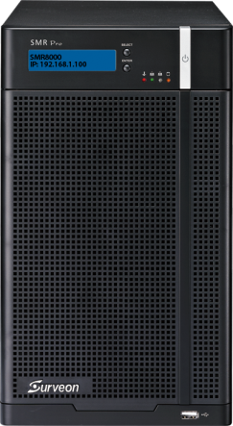
Surveon Enterprise SMR8300
Product Introduction
Sales & Marketing Department
Surveon Technology

Slide 2

The Contents
2
SMR8300 Key Values
SMR8300 Overview & Position
SMR8300 Feature Highlights
Appendix

Slide 3
3
SMR8300 Key Values

Slide 4






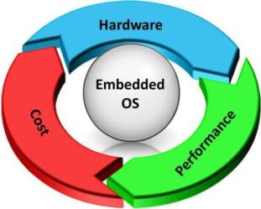
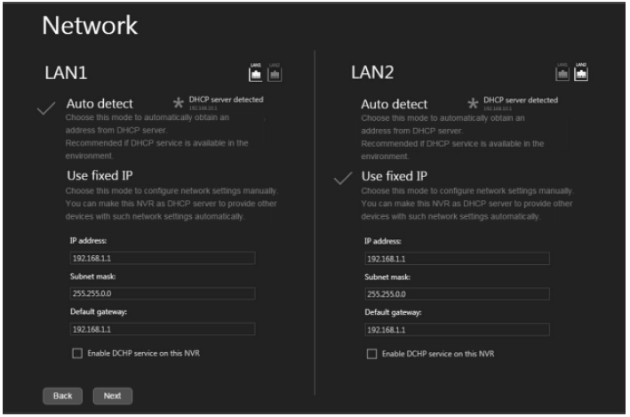
SMR8300 Key Values - 1
4
High Reliability &
Easy Maintenance
Megapixel Recording
Optimization
Easy Installation
& Operations
an affordable solution for entry to middle-range surveillance projects.
Support 16 to 64 channels and up to 8 swappable HDD on the Linux platform, with dedicated hardware design and industrial-grade components for enterprise projects.
Built-in RAID 1, 5, 6 for the maximum performance and large data protection.
Simple and quick installation by wizard, advanced live view, playback, configurations, and centralized management.
Performance
Unified client for local, remote, web, mobile views
SMR83000
PC+SW NVR
Mobile access via iPhone, iPad, Android
Time
I/O High
Average 50% higher I/O performance
compared to the PC+software NVR solutions for megapixel recording.
Simple & quick configurations with Wizard

Slide 5
















SMR8300 Key Values - 2
5
Enterprise Video
Management
Real-time
Video Analytics
Scalable CMS
Solutions
Enterprise VMS functionalities for professional security projects.
10 real-time video analytics engines for advanced
security projects.
Support 1000+ channels, 300+ NVR, 180 recording days and advanced TV wall.
E-Map
Alarm Management
Virtual Fence
Intrusion Detection
Matrix Client
Matrix Client
Smart Search
360° Fisheye
Object Detection
Object Counting
Operator 1
Operator 2
Operator 3
Centralized
Management
Rule
Management
Going Out Detection
Direction

Slide 6
6
SMR8300 Product Overview & Position

Slide 7
SMR8300 Model Series
7
 | SMR8300E | SMR8300A
Position | Enterprise Megapixel NVR
Form Factor | All-in-one Desktop (Tower)
CPU | Intel® Core i3 | Intel® Core i7
Channel | 16 – 32 Full HD | 16 – 64 Full HD
Recording Throughput | 200 Mbps | 400 Mbps
Max. VI | 8
HDD | 8 (Hot-Swappable)
Storage Expansion | NAS/iSCSI
RAID | Non RAID, 1, 5, 6 (built-in)
I/O Interface | 2x Gigabit Ethernet 6x USB2.0 1x VGA, 1x HDMI
Power Supply | 430 W
Dimensions | 310(H) x 175(W) x 380(D) mm
Local Display | Dual Monitors
Surveon Control Center (CMS) | Yes
Operating System | Linux
Warranty | 3 years

Slide 8
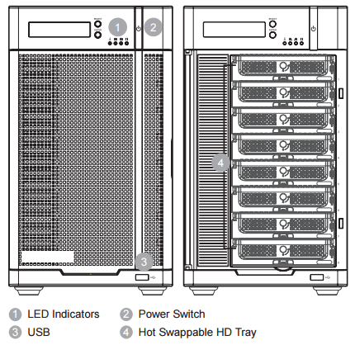
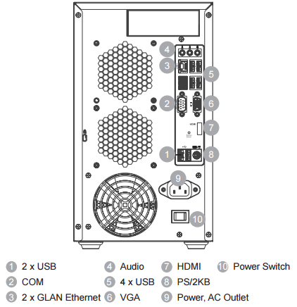
SMR8300 Hardware Views
8
Front View
Rear View

Slide 9

SMR8300 Target Applications
9
Enterprise, Highly Reliable NVR for Entry to Middle-Range Projects.
Smart Building
SMBs
Retail/Supermarket
Hotel/Restaurant
School
Manufacturing
SMR8300 Key Values
Enterprise VMS
Reliable Video Recording
Easy Operations
Megapixel Quality
Centralized Management
Scalable Architecture

Slide 10
10
SMR8300 Feature Highlights

Slide 11
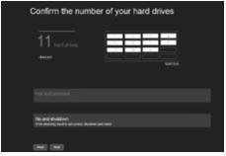
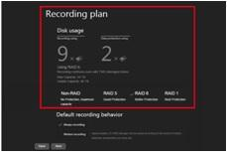
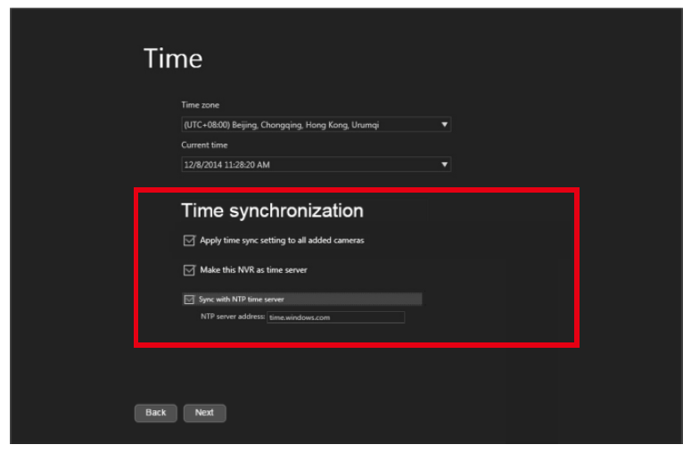
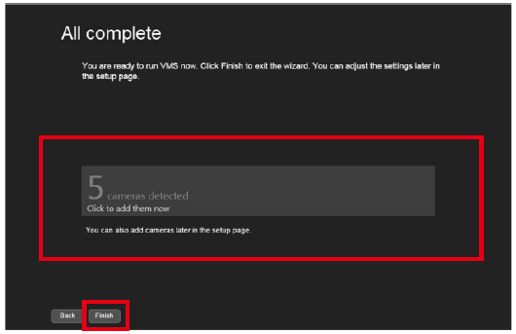

Simple Configurations with Wizard
11
Built-in OS and VMS - no installation required.
Step by step Wizard to complete setup and configurations in 5 minutes!
1. Auto Detect HDD
2. Confirm Recording Plan
3. Confirm Network Settings
4. Time Synchronization
5. Auto Detect Cameras
6. Setup Completed

Slide 12
Optimized for Megapixel Surveillance
12
16 to 64-channel Full HD 30fps recording.
Support up to 8-bay hot-swappable HDD storage capacity.
Support NAS/iSCSI for large data storage.
Built-in RAID 1, 5, 6 for data protection.
Built-in enterprise VMS functionalities.
Designed for entry to middle-range projects.
SMR8300 Enterprise
Megapixel NVR

Slide 13
Professional NVR Design
13
Dedicated hardware design for enterprise NVR.
All-in-one desktop form factor.
Industrial–grade components.
Linux-based, virus-free reliable solution.
100% in-house design and production.
SMR8300 Enterprise
Megapixel NVR

Slide 14

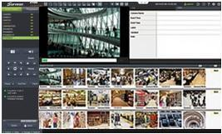

Built-in Surveon Enterprise VMS
14
Intuitive platform makes it easy to use.
Intelligent search improves operation efficiency.
Optimized features for megapixel surveillance.
Multi-access makes management simple and flexible.
Advanced Live View
Intelligent Playback
Advanced VI

Slide 15


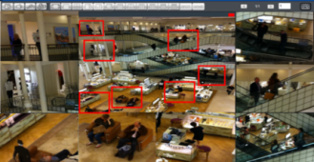
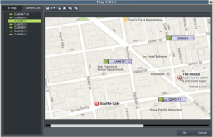
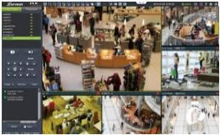
Enterprise VMS: Advanced Live View Controls
15
Advanced live view includes fisheye dewarping, PAP, multiple views, dual monitors, e-map, alarm rules, and more.
Fisheye Dewarping
PAP View
E-Map
Multiple View Control

Slide 16
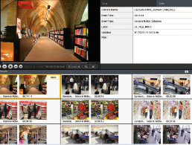
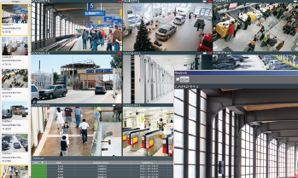

Enterprise VMS: Complete & Intelligent Playback
16
Support fisheye dewarping playback.
Support 4, 9 and 16-channel synchronized playback.
Support playback by events.
Support playback by Video Intelligence (VI).
Support instant playback in live view.
Event Playback
VI Playback

Slide 17




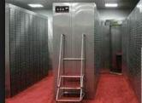


Enterprise VMS: Built-in Advanced Video Analytics
Access Detection
Virtual Wall
Residential areas
Surroundings of hotels
campus, factories
Important buildings
Hotel reception areas
Entrances of hospitals,
residential areas
Restricted Zone
Virtual Fence
域
High value products
Important facilities,
Properties
Public objects
No-parking zones
Entrances of warehouses
Important facilities
Tailgating Detection
Counting
ATM areas
Garages, parking lots
Access controls
People flows in stores
Business VI integrations
Warehouses
Department stores

Slide 18
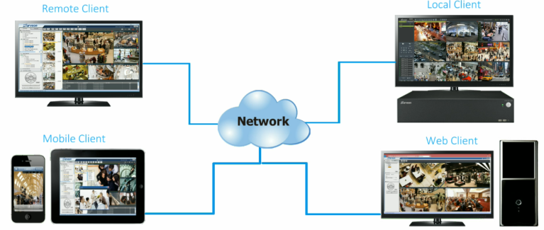
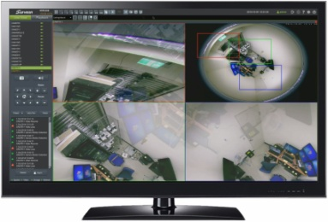
Enterprise VMS: Multi-Access for Easy Surveillance
18
Local client: monitor in the local security office.
Web client: monitor on the web.
Remote client: monitor in the home office.
Mobile client: monitor on the mobile phone or tablet.
Remote Client
Local Client
Mobile Client
Web Client

Slide 19

Surveon Control Center (CMS) for Scalable Projects
19
Unlimited number of cameras, NVRs, monitors, and users supported in one domain.
Simultaneous live views of cameras from multiple NVRs.
Smart search and advanced e-map over multiple NVRs.
Central alarms to collect event data from different NVRs, hardware, I/O devices, VI, and critical system status.
Centralized account management.
Scalable client-server architecture for large-scale projects.

Slide 20
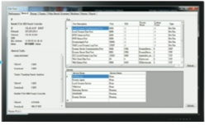
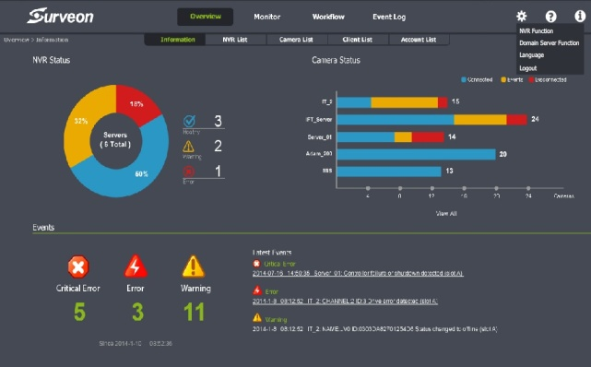
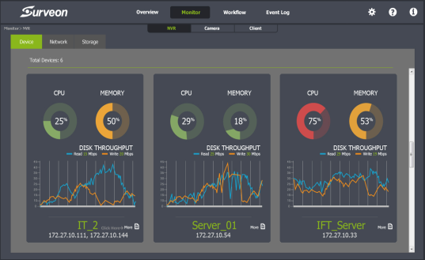
Smart Remote Monitoring
20
TV wall matrix: simultaneous live views of over 200 cameras from multiple NVRs, often used in places like traffic control rooms.
SurveOne: a remote monitoring tool provides users hardware system overview, setup and event status for easy management.
SurveOne System Overview
SurveOne Live Monitoring

Slide 21









SMR8300 with Integrated Solutions
21
Integrate and manage all kinds of videos, alarms, events, and data.
Execute and manage the surveillance system in one unified platform.
Video analytics and real-time alarms.
Surveon Control Center Solutions
Access Control
Applications: hotels, office buildings, airports, residential areas, shopping malls and so on.
Fire Alarm
Alarms
Collect data from different alarm systems such as HTML, I/O.
Controls
Intrusion Detection
Alarms
3rd Party Surveillance Systems
Surveon CMS
HD Videos
Controls
Intelligent
Management
Access Control
Intrusion Management
HD Surveillance
Video Analytics
Ｉ/O Controls

Slide 22

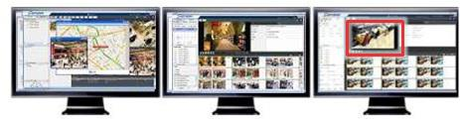





Active Video Intelligent Alarm System
22
Support VI notifications to ensure rapid and accurate decisions.
Real-time VI Analytics & Notifications
Alarm Rules Settings
Real-time Video Analytics
VI Management
Virtual Wall
Access Control
Tailgating Detection
Support real-time VI notifications and labels
Real-time Event Notifications
Triggered event
popups videos
When an event is triggered, the monitors will switch to display its surrounding images.

Slide 23
Summary – Why SMR8300 Series
23
Position : Enterprise megapixel NVR
Target: 16 to 64-channel entry to enterprise projects.
Key Values:
Built-in Surveon enterprise VMS, with 8 hot-swappable HDDs.
Built-in RAID protection optimized for megapixel recording.
Built-in advanced video analytics functionalities.
Scalable with centralized management.
Installation and integration free.
SMR8300 Enterprise Megapixel NVR

Slide 24
24
Questions and Answers

Slide 25
25
Appendix

Slide 26

Camera Support Capability
26
The camera models from the following providers have been fully tested for compatibility with
Surveon NVR. For models supported by SMR8300, visit Surveon Support Camera List.

Slide 27
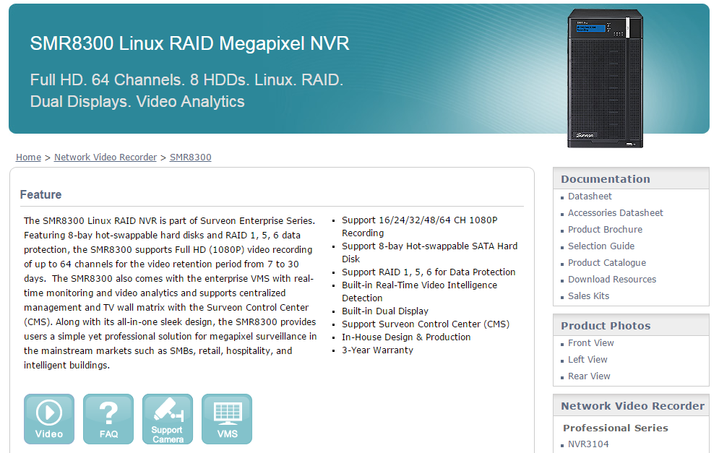
SMR8300 Sales Package
27
Find demo video, FAQ, user manual, datasheet, leaflet, brochure, AE spec:
http://www.surveon.com/product/SMR8300.asp
Notes:
27

Slide 28
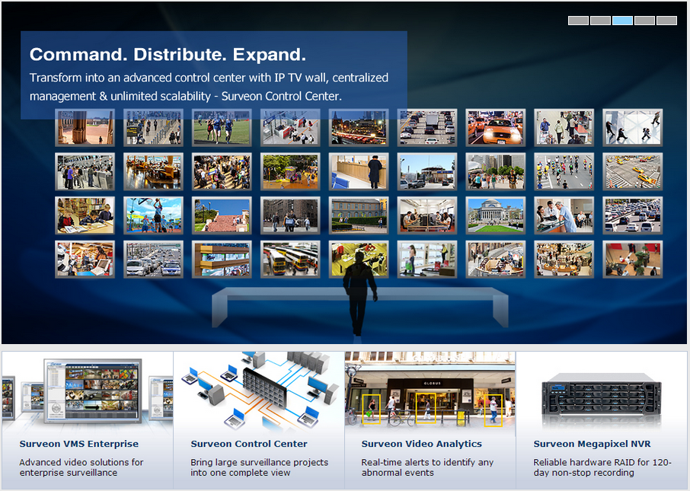
Surveon Enterprise VMS
28
SMR8300 pre-installs the latest Surveon enterprise VMS.
Find all VMS related sales materials: http://www.surveon.com/vms/index.asp

Slide 29
29
More Info about Surveon Solutions
www.surveon.com
sales@surveon.com

